Slide 1
Java Writer class
Writer
BufferedWriter
CharArrayWriter
FilterWriter
OutputStreamWriter
PipedWriter
PrintWriter
StringWriter
Writer class is an abstract class for writing to character streams.

Slide 2
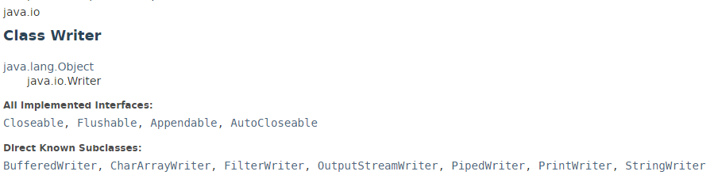
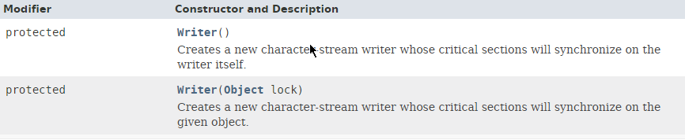
Java Writer class

Slide 3
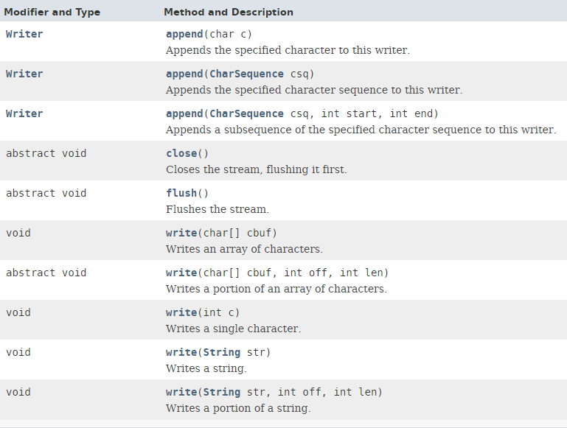
Java Writer class

Slide 4
Java Writer class
https://docs.oracle.com/javase/8/docs/api/index.html?java/io/Writer.html

